Slide 1
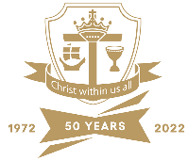

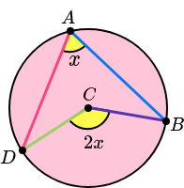
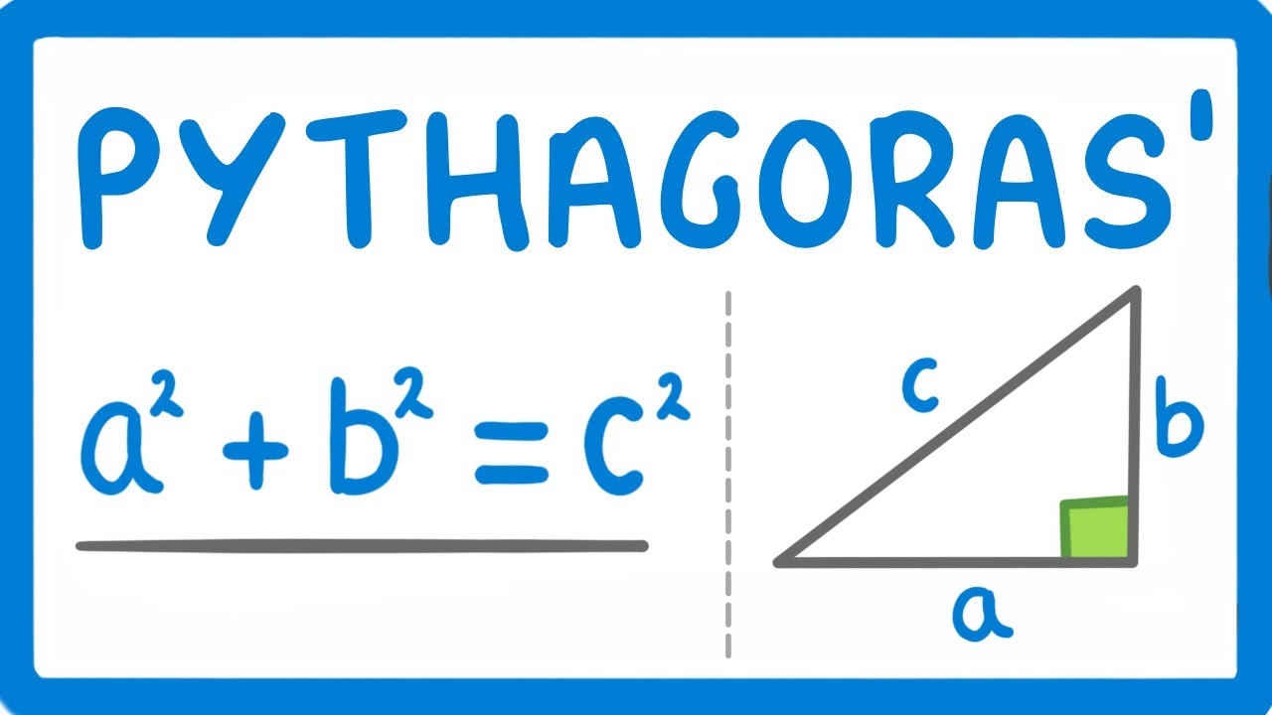

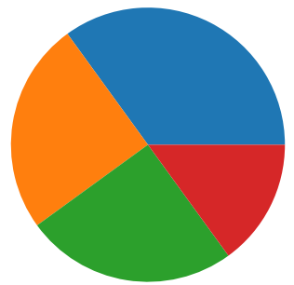
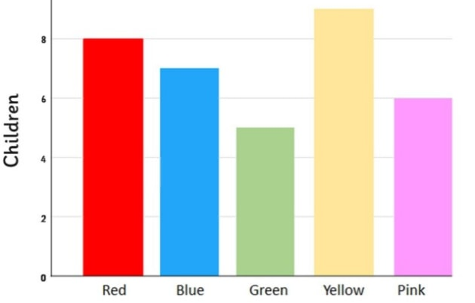
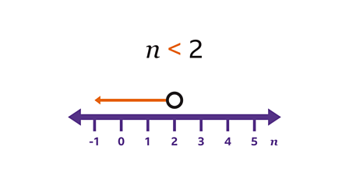
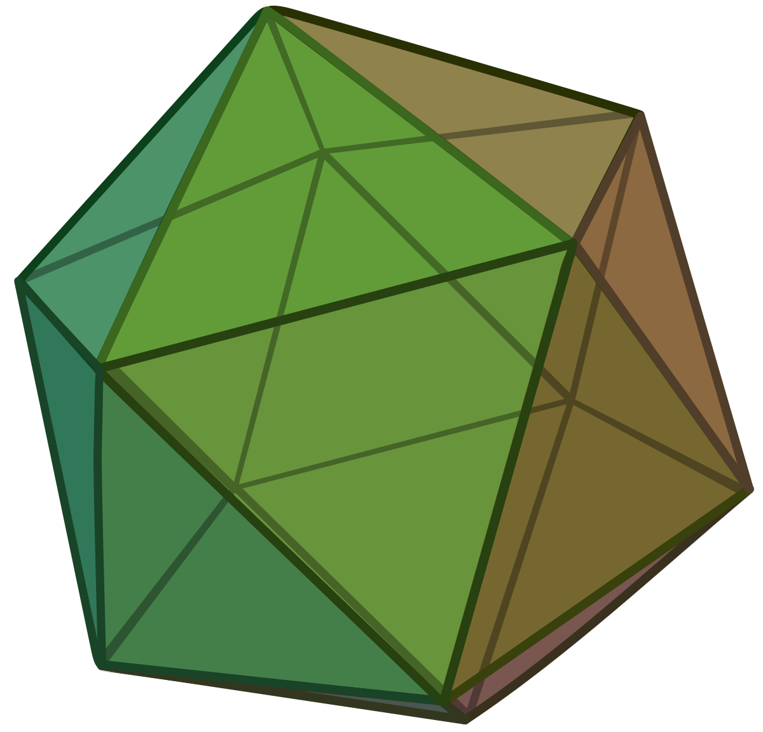

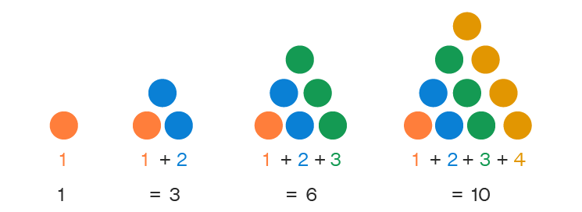


Mathematics Curriculum Map
Spring Term 1
Spring Term 2
Sixth Form / Further Study
Accountancy • Mathematics • Further Maths • Physics • Chemistry • Engineering • Computer Science • DT • Geography
Sketching quadratics
Perimeter, area and circles
3D forms and volume
Changing the subject of formulae, algebraic fractions and rationalising surds
Vectors and geometric proof
Direct and inverse proportion
Exams
Next Steps
Careers
Analyst • Accountant • Engineering • Education • Mechanic• Marketing • Pilot • Medicine • Researcher • Scientist•
Skills
Analysis • Attention to Detail • Communication • Accuracy • Problem solving • Resilience • Reasoning • Patience • Logical Thinking
Mock Exams, Revision and targeted support
Super-curricular links
NRICH, Tomrocksmaths (Youtube), The Oxford Online Maths Club
Autumn Term
Accuracy and bounds
Solving quadratics and simultaneous equations
Inequalities
Similarity and congruence
Data handling
Summer Term 2
Summer Term 1
Spring Term 2
Spring Term 1
Constructions, loci and bearings
Revision and mock exams
Quadratic, cubic and other graphs
Circle theorems
Circle Geometry
Transformations
Graphs
Coordinate geometry
Ratio and proportion
Polygons, angles and parallel lines
Pythagoras’s Theorem and trigonometry
5&6
Revision and targeted support
Autumn Term 2
Spring Term 1
Spring Term 2
Summer Term 1
Summer Term 2
Autumn Term 1
Sequences
Averages and range
Representing and interpreting data
Fractions and percentages
Numbers
Using percentages
Maths and money
Deduction
Rotation and translation
Pythagoras’ Theorem
Enlargement and similarity
Ratio and proportion
Rates
Probability
Algebraic representation
Rounding
Indices, roots, reciprocals
Factors, multiples and primes
Solving and rearranging equations
Autumn Term 2
Three dimensional shapes
Constructions and congruency
Autumn Term 1
Summer Term 2
Summer Term 1
Spring Term 2
Spring Term 1
Straight line graphs
Forming and solving equations
Testing conjectures
Symmetry and reflection
Data handling
Measures of locations
Angles in parallel lines and polygons
Area of trapezia and circles
Fractions and percentages
Number sense
Brackets, equations and inequalities
Sequences
Indices
Standard Index Form
Revision and targeted support
Summer Term 1
Summer Term 2
Autumn Term 1
Autumn Term 2
Addition and subtractions of fractions
Constructing and geometric notation
Geometric
reasoning
Developing number sense
Sets and probability
Prime numbers and proof
Ratio and Scale
Multiplicative Change
Multiplying and dividing fractions
Working in the Cartesian plan
Representing data
Probability
End of Year Assessment
Spring Term 2
Primary School Curriculum
We work with our primary school partners to make sure we get to know you and you get to know us and what we teach you links up and follows on from what you have learnt already
Fractions and percentages of amounts
Four operations with directed number
Spring Term 1
Autumn Term 2
Autumn Term 1
Solving problems with addition and subtraction
Solving problems with multiplication and division
Place Value
Fraction, decimal and percentage equivalence
Sequences
Algebraic Notation
Equality & Equivalence
Taster
Sessions
Transition Days

