Slide 1
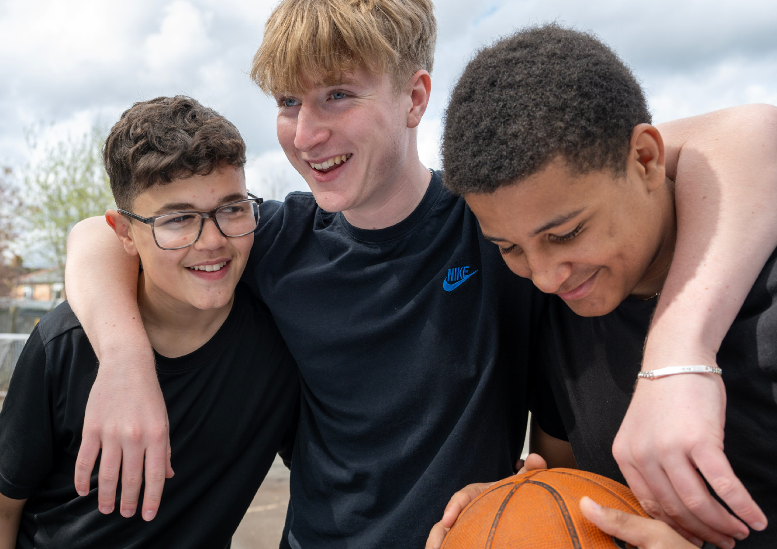

Slide 2
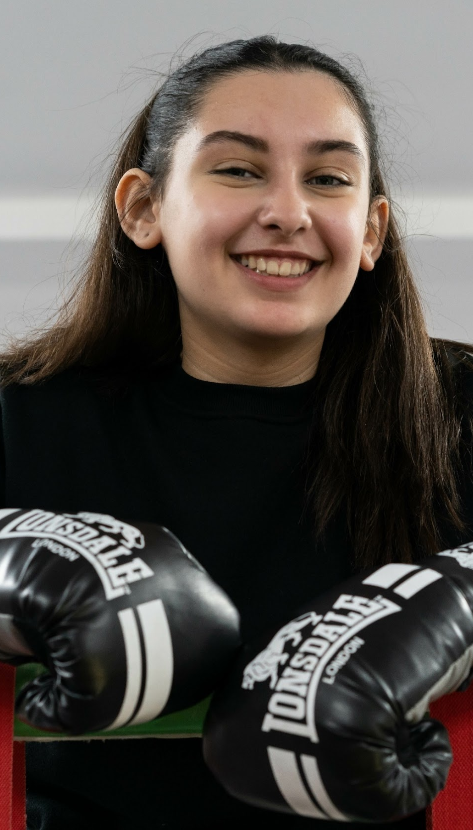
A parent and carer’s guide to DofE

Slide 3
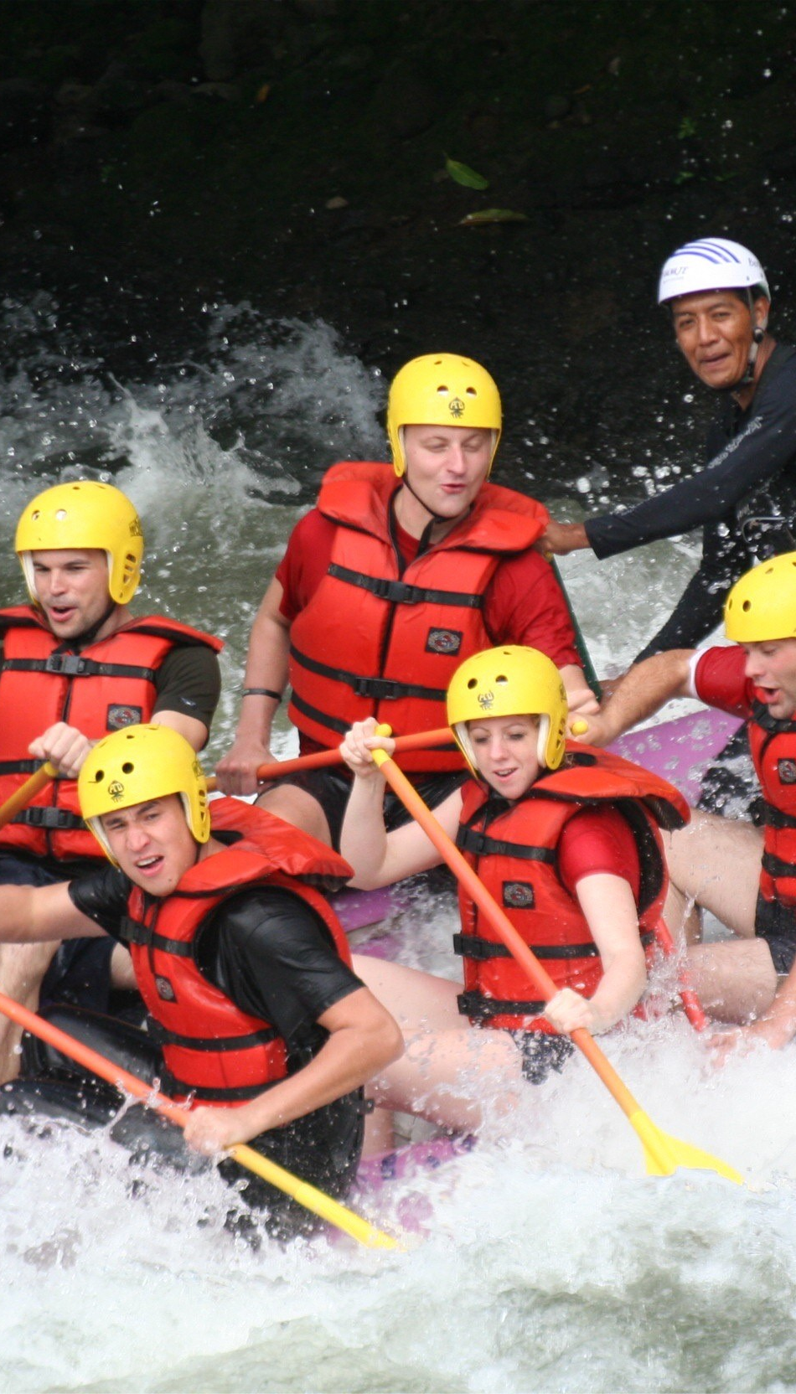
What is DofE?
DofE is a life-changing adventure for young
people aged 14*-24.
It empowers young people to build essential life and work skills. It encourages personal growth, resilience, and confidence.
Notes:
*school year they turn 14

Slide 4

Introducing DofE
Notes:
The following film provides an overview of the Duke of Edinburgh's Award. ​

Slide 5
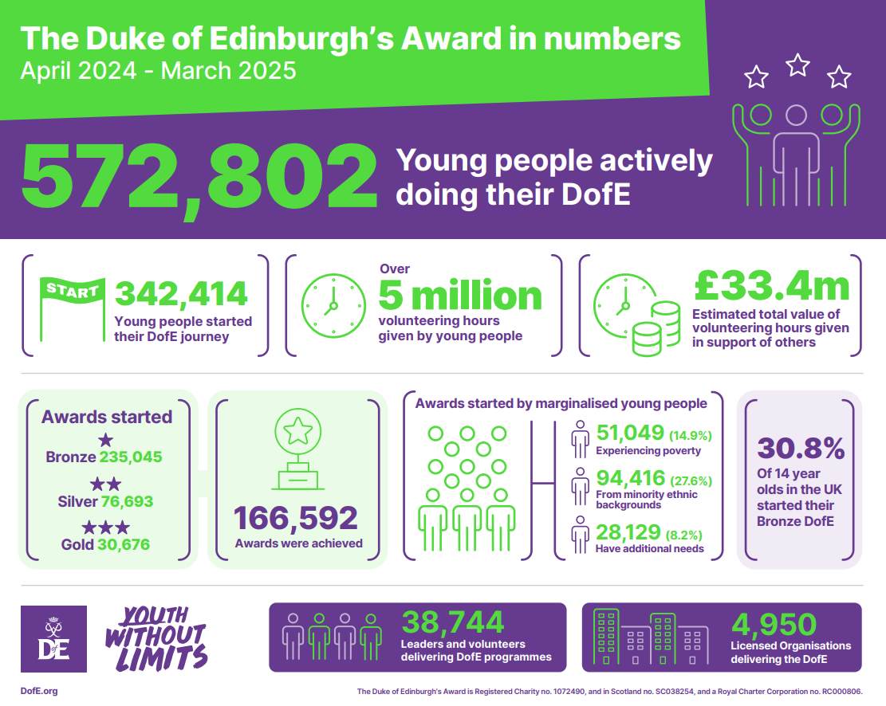

Slide 6


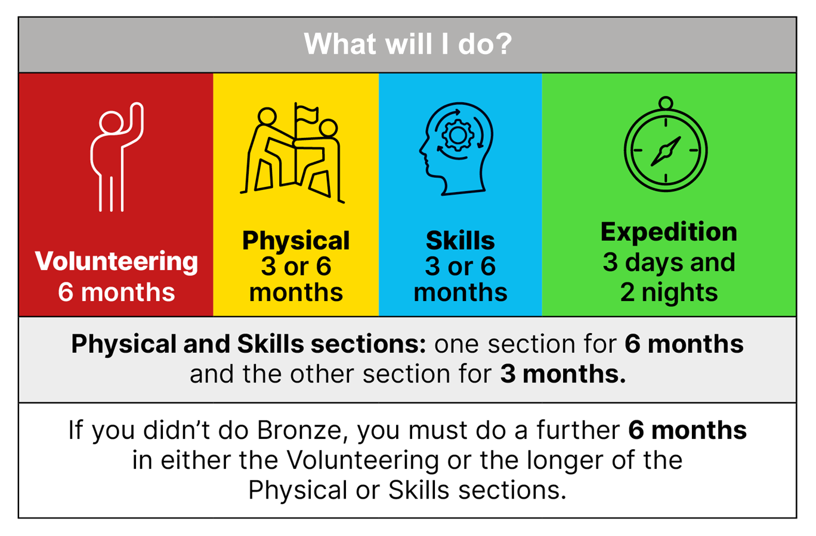
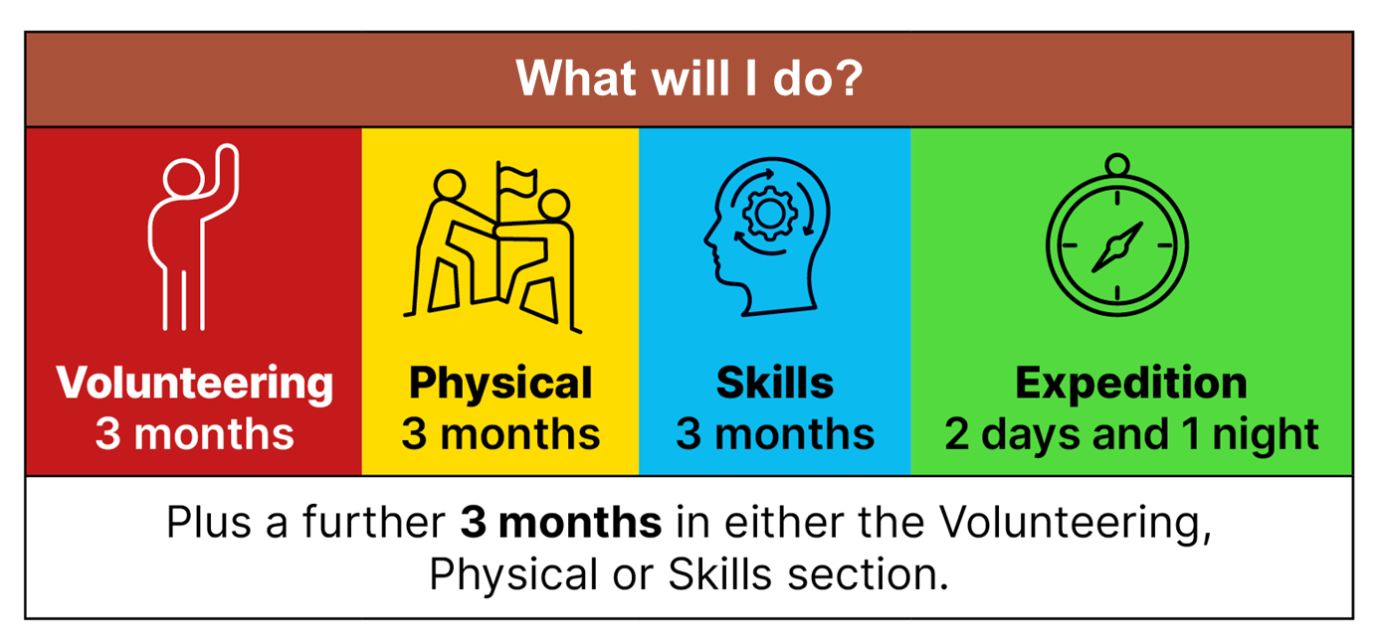

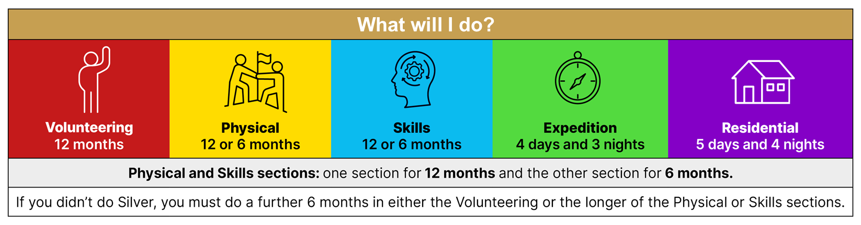
What is involved?
Notes:
There are three levels of DofE Award – Bronze, Silver and Gold. To achieve their Award, your child will need to complete four sections – Volunteering, Physical, Skills and Expedition (add residential for Gold). ​
​The length of time they will need to devote to each section will vary, depending on whether they are at Bronze, Silver or Gold level.​
Choosing which activities to do for each section may seem daunting for your young people. But it’s important to remember that most activities can count.
Many young people will already take part in activities which can be counted towards their DofE Award, and there are a huge number of activities on offer for young people who are keen to try something new.​
​It is important to make sure that the young people are keeping a record of the time they spend on each activity. They may need your support to find an assessor for each section.
Assessors are people who check that activities have been completed and describe the progress that has been made. An assessor should be somebody who has a good understanding of the chosen activity. It can be anyone apart from members of your family.​
​I will now describe each section of the award in more detail.​
​

Slide 7
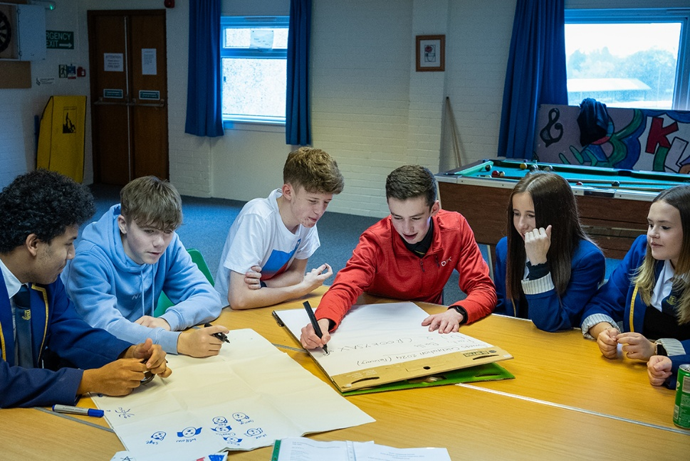
Choosing activities
Check the activity
Remember to check if what they are planning to do is permitted for the section with their Leader.
Choosing an activity
Make sure the activity is something they enjoy! There are lots of different activity ideas for each section.
Preparation
Ensure you and your young person complete the relevant research and agree their activity with their Leader.
Ensure the activity is safe. You may need to ask the provider of the activity what safety measures they have in place.
Where can I do an activity?
Activities can be completed at their organisation or in their local area.
Their DofE activities must be complete outside of their mandatory lessons or paid employment – they must be completed in their own time which is why it is important to find things they enjoy!
4 May 2021
Notes:
It is important to choose appropriate activities at the start. Participants should check these with their DofE leader and make sure that they have an appropriate Assessor before they start the activity. Its important the activity is submitted on eDofE and approved before the young person starts. You may ask participants to complete a Bitesize Planner before putting your plan on eDofE.

Slide 8
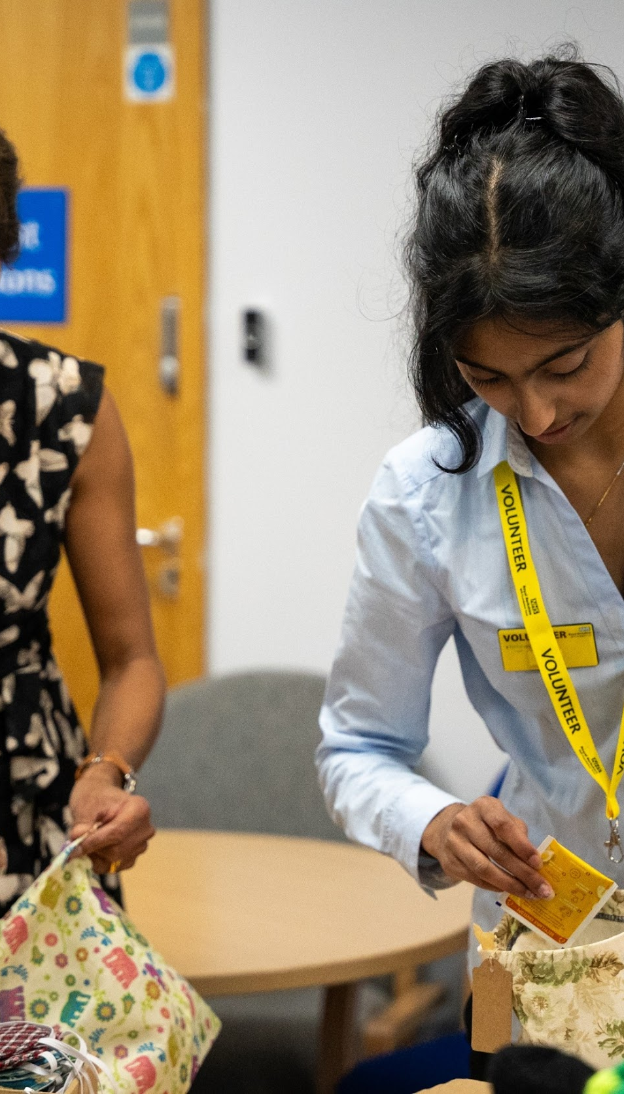
Volunteering section
Helping others and
making a difference
to the causes they
care about.
Notes:
Every young person who pursues a DofE award will be asked to devote some time to volunteering.​
​
Through volunteering, young people have the opportunity to give up their time to help others or to make a difference to causes they feel passionate about.​ From coaching a local football team to starting a recycling campaign, they’ll give up their time to help others and change things for the better.
As well as changing things for the better, volunteering can be incredibly rewarding for young people – growing their confidence and sense of independence and gaining new skills they can use in their future lives and careers.​
​Examples of volunteering could be coaching a local football team, collecting items for a foodbank or campaigning for change on issues they feel passionate about.
Presenter: Feel free to use examples of previous participants here.
​The amount of time young people will need to volunteer for will vary depending on whether they are pursuing a Bronze, Silver or Gold Award. ​
​Young people can choose to volunteer in any area they would like – the only rule is that young people must not be replacing paid labour, for example by volunteering for commercial organisations.​
​

Slide 9
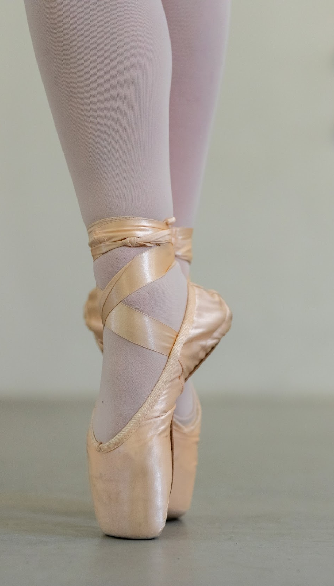
Physical section
Improving their health
and fitness and having fun along the way!
Notes:
A key component of any DofE Award is the Physical section, through which young people are encouraged to take part in regular physical activity. ​
​We know that regular physical activity improves young people’s physical and mental health so is a great habit to acquire when still young.​
​Almost any dance, sport or fitness activity can count – it’s completely up to them which activities they choose, including whether they seek to join a team or choose to do an activity on their own.​
​Completing the Physical section might be the push needed for a young person to try something completely different, or to concentrate and improve on something they are already doing. ​
​
​

Slide 10
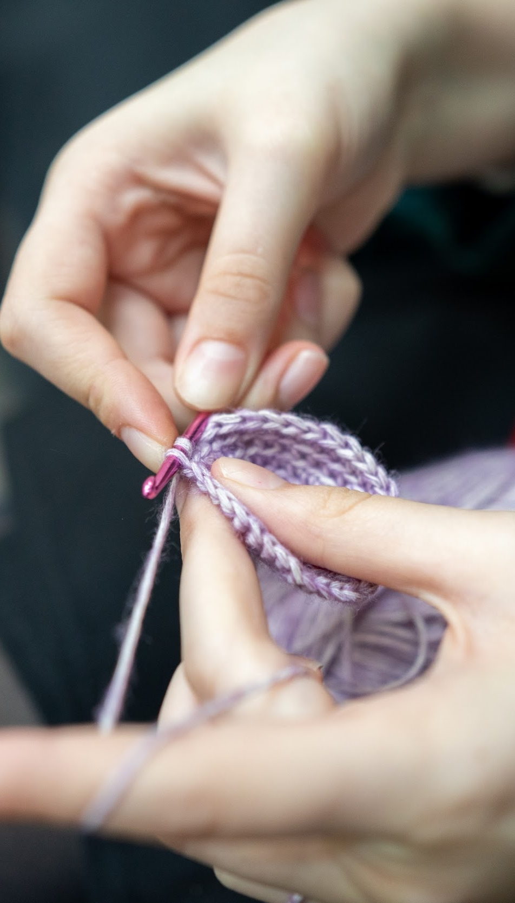
Skills section
Developing existing
skills or discovering
new things to love.
Notes:
Through the skills section, young people are encouraged to develop a set of practical and social skills.​
​They will be able to choose whether to develop their skills in areas where they have an existing passion, or to learn about something new.​
In the past, young people have used their skills section to develop their interests and talents in a huge range of areas including computer coding, driving and cooking
Presenter: please add in your own examples here.
​Through gaining interests and talents, young people will enjoy themselves and feel a real sense of achievement.​
​They’ll grow their confidence and show they’re committed, motivated and can rise to a challenge.​
​
​

Slide 11
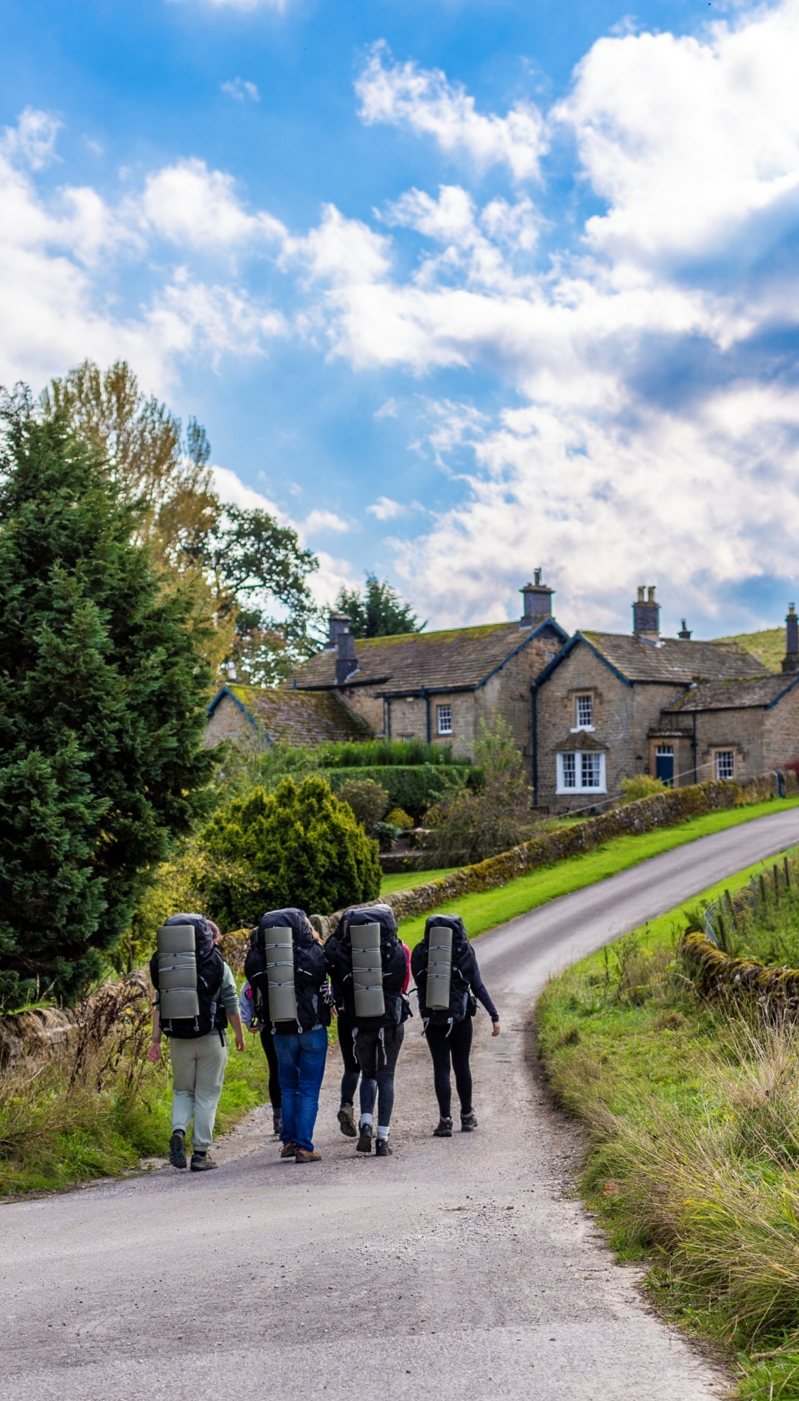
Expedition
Spending time in the great outdoors and creating
lifelong memories.
Notes:
As part of a team, they will receive training in areas such as first aid, navigation and camp craft, participants will then work together to achieve a specific team goal of their choosing.
​
​

Slide 12
Practice Expedition Details
Bronze DofE Practice Expedition – Saturday 18th April
Location: Loggerheads Country Park, Ruthin Rd, Mold, Denbighshire, CH7 5LH
Meeting Point: Overspill car park (up the hill before the main car park)
Arrival Time: 09:30
Pick-Up Time: Approx. 14:00
Expedition Overview:
Students will be grouped with a supervising staff member.
After a briefing and equipment check, groups will start a 9km loop, including Ffrith Mountain.
Students will practice navigation skills in pairs under supervision.

Slide 13
Qualifying Expedition Details
Bronze DofE Qualifying Expedition – Saturday 16th & Sunday 17th May
Location: Bibby’s Farm Campsite, Back Lane, Heath Charnock, Chorley, PR6 9DL
Departure from School: 09:30 (arrive 09:00 for final kit check)
Return to School: Approx. 16:30 on Sunday
Expedition Overview:
Students will travel by coach to the campsite.
Walking groups of 8 will complete circular routes, navigating independently with maps and compasses.
Staff will monitor five checkpoints to ensure safety and support.
Evening: set up tents, prepare meals, relax under supervision.
Sunday: breakfast, break down tents, complete a second walk, then return to school.
Tents, rucksacks, stoves, maps, and compasses are provided. Students bring personal kit and food.

Slide 14
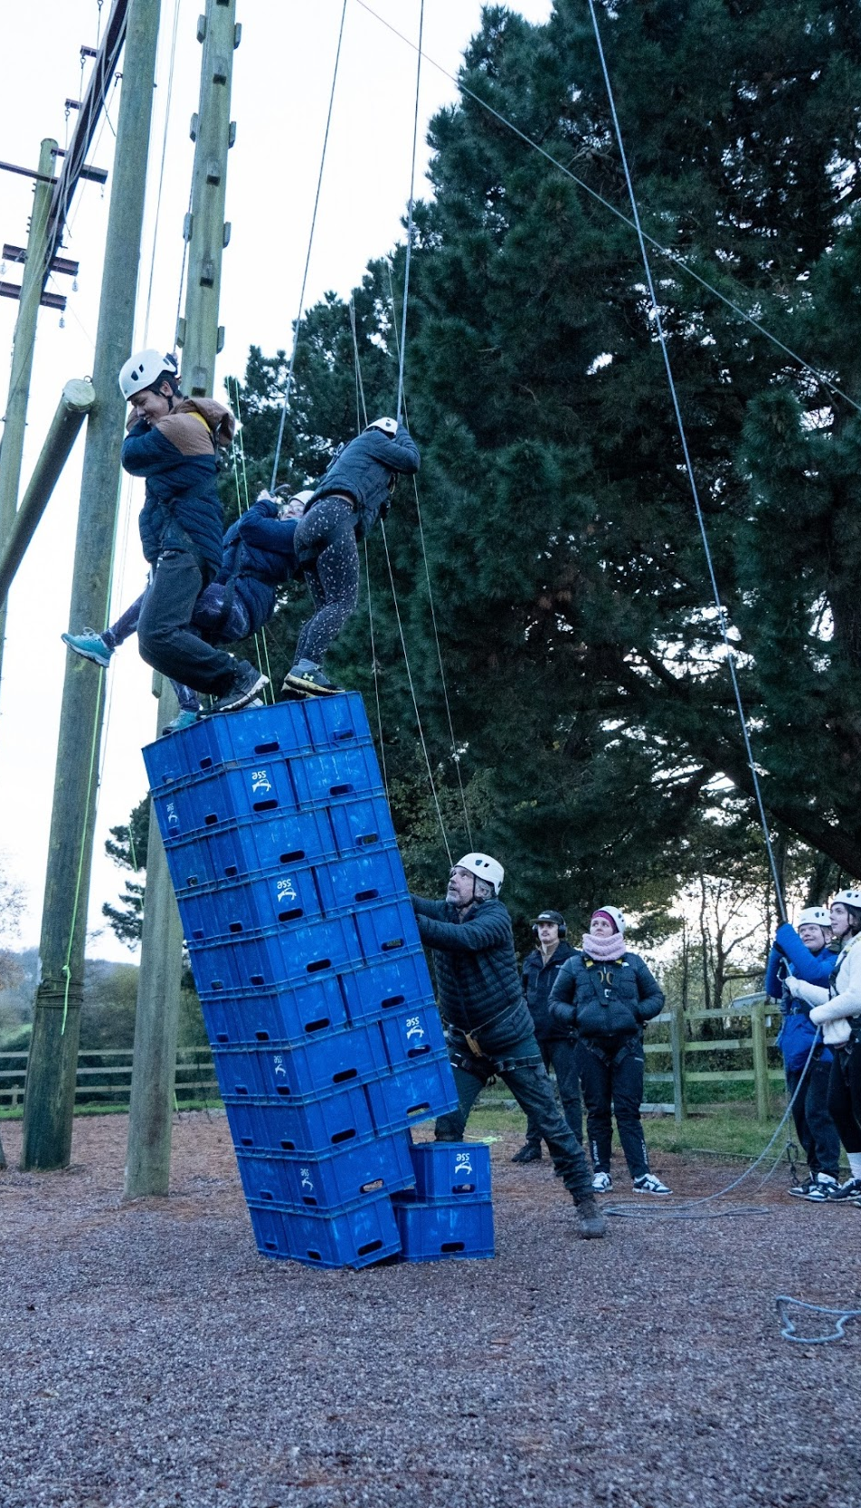
Residential
(Gold Award only)
Five days and four nights away from home.
Sharing experiences and creating new connections.
Notes:
As part of a team, they will receive training in areas such as first aid, navigation and camp craft, participants will then work together to achieve a specific team goal of their choosing.
​
​

Slide 15

DofE.org
Visit our website for the most up-to-date information and guidance.
Notes:
Mention Do DofE pages,. Resource Centre for participant resources

Slide 16

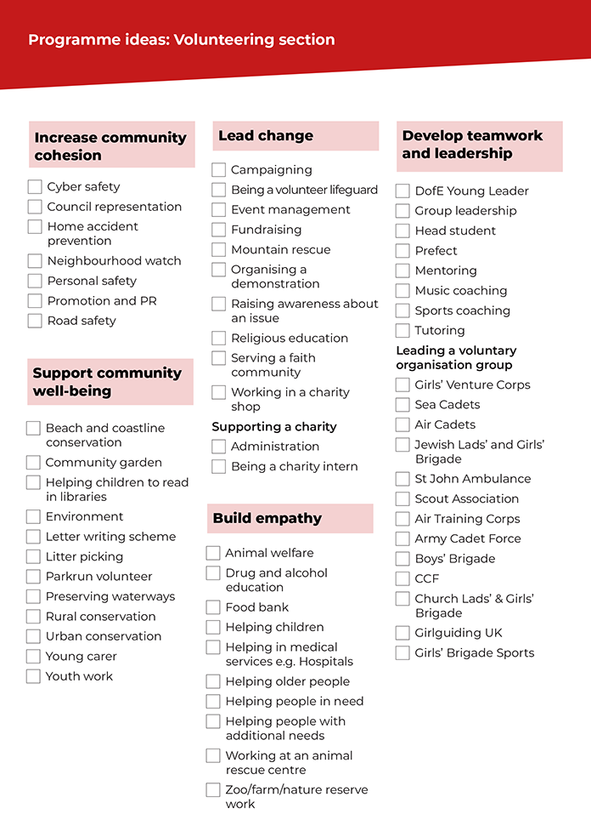
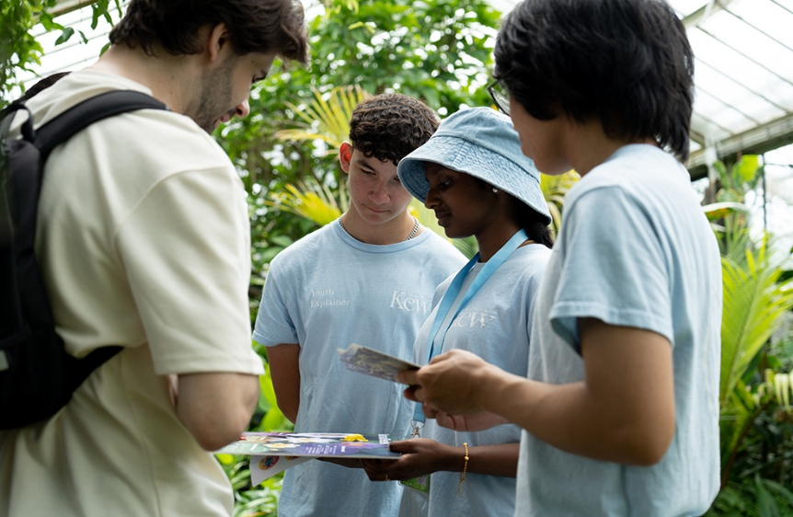
Programme ideas
For more ideas, use our Programme Ideas sheets or head to the Opportunity Finder for local approved opportunities.
4 May 2021
Ideas for Activities - The Duke of Edinburgh's Award
Notes:
It is important to choose appropriate activities at the start.

Slide 17
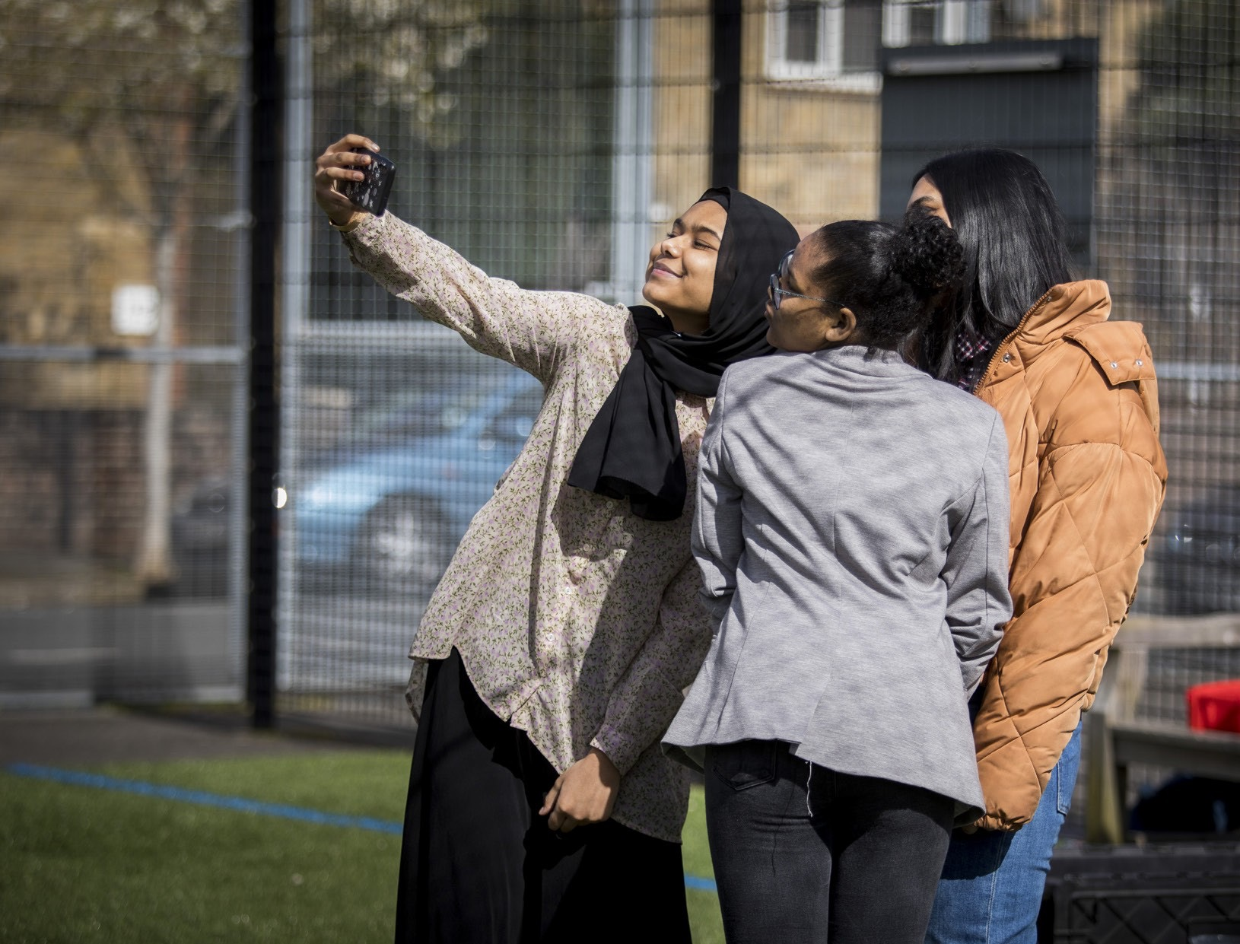
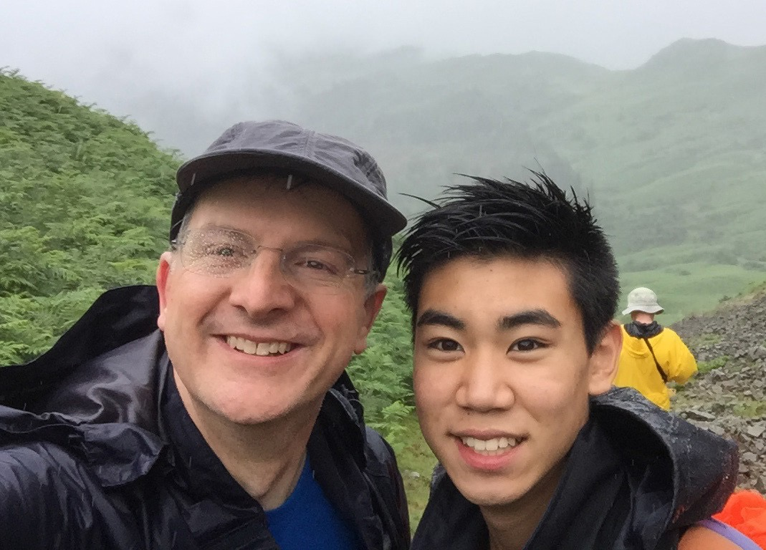
Your role
Your role
Guidance
Encouragement
Practical support
Recognise achievement
All expeditions are inclusive and if you
need any adjustments please reach out
to your organisation's DofE Manager.

Slide 18
Key milestones
Enrol
Login to eDofE
Add your section activities
Leader approves activities
Start activities
Enrolled to eDofE
  The Leader will add the young person to eDofE and they will receive their username and password.
Within two weeks
  Login to eDofE within two weeks of being enrolled.
Within four weeks
  Choose activities
  for at least one section and submit to the leader.
Within six weeks
  The Leader will let them know if there are any problems with the activities and help them.
Within eight weeks
  At eight weeks after they were enrolled, they should have started at least one of their activities and keep track using the App.

Slide 19
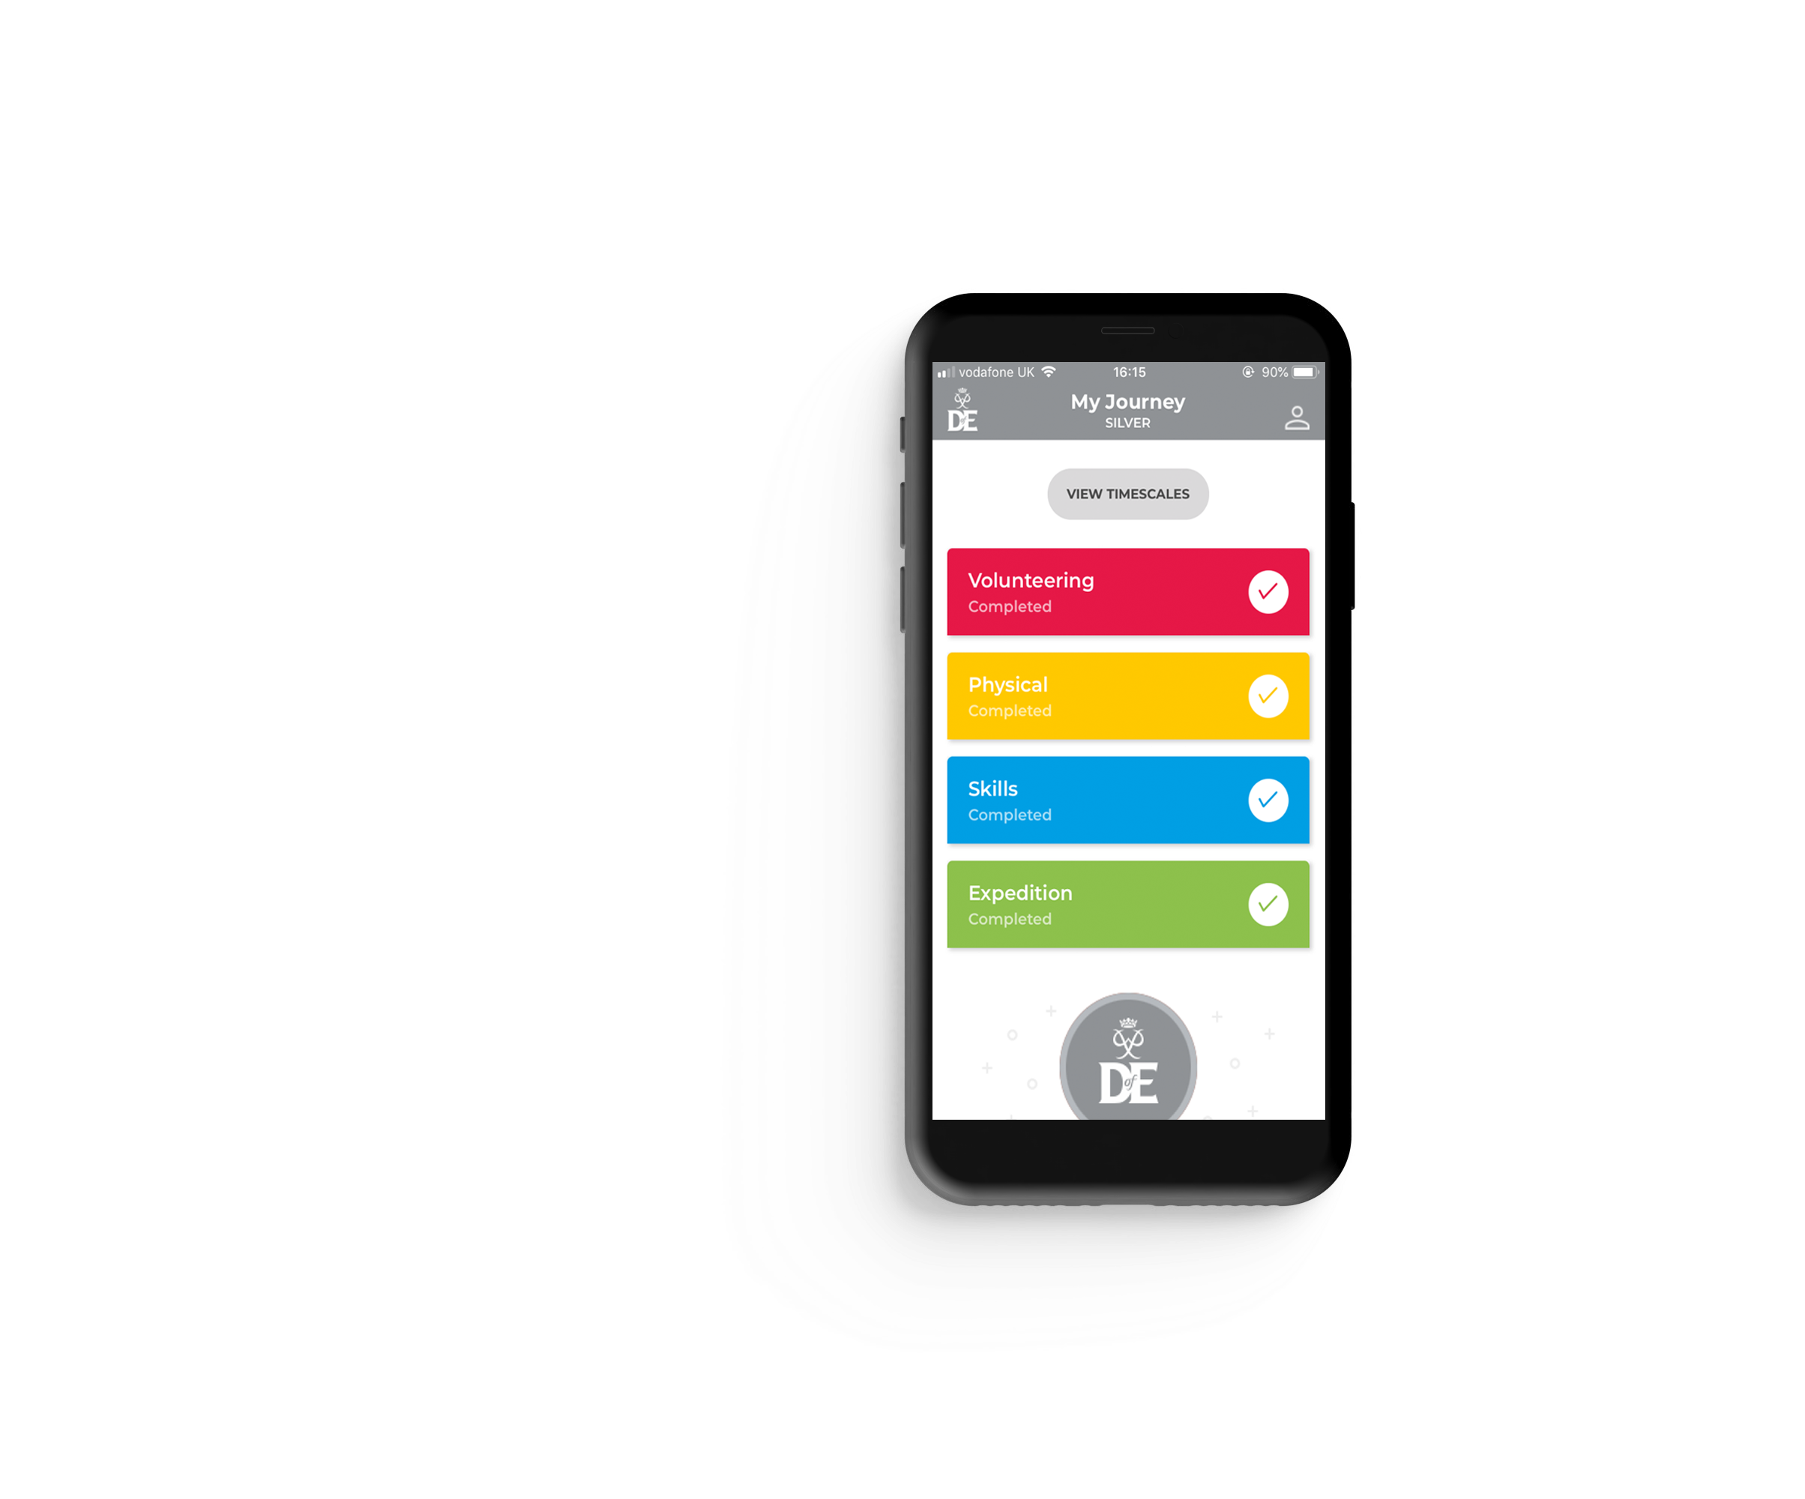

Your Welcome Pack and eDofE

Slide 20
Assessors
Each activity requires an Assessor to confirm the activity. On completion of the section, the assessor will complete an Assessor’s Report to confirm the activity was carried out for full timescale, showing commitment and effort.
Who is suitable to be an Assessor?
Any adult who has a good understanding of the activity they are doing and has witnessed them take part. However, they cannot be anyone related to the participant.

Slide 21
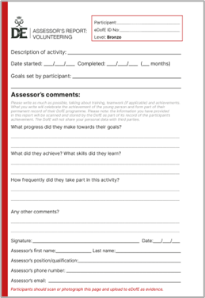
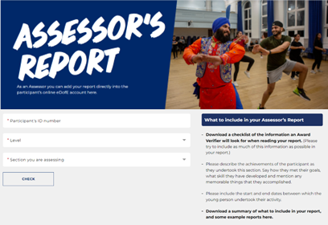
Assessor Reports
Each section needs a report completed by an adult Assessor. This can be submitted through the Assessor’s portal or on the cards that they will receive with your Welcome Pack.
Participants should complete:
Name; ID number; Award Level
Description of activity
Start and end date
Timeframe chosen for section
Goals

Slide 22
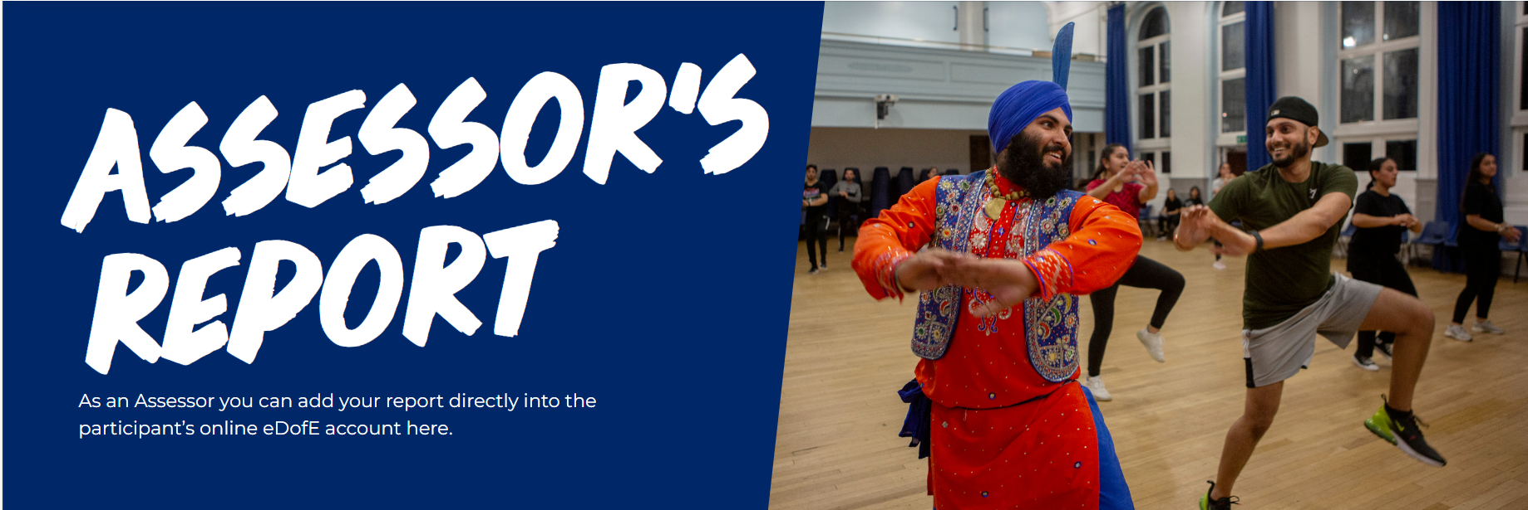
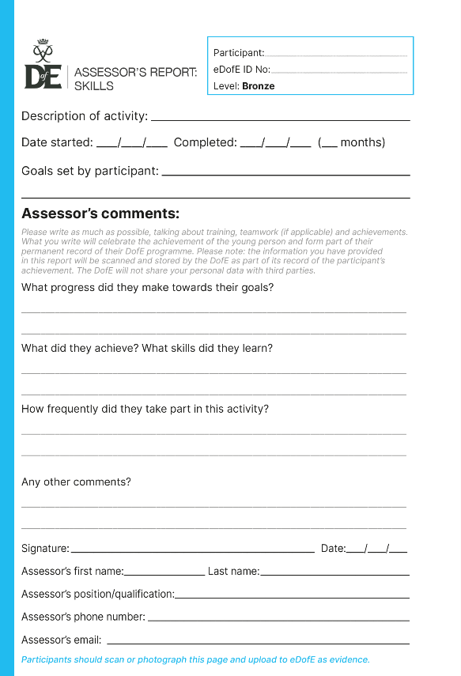
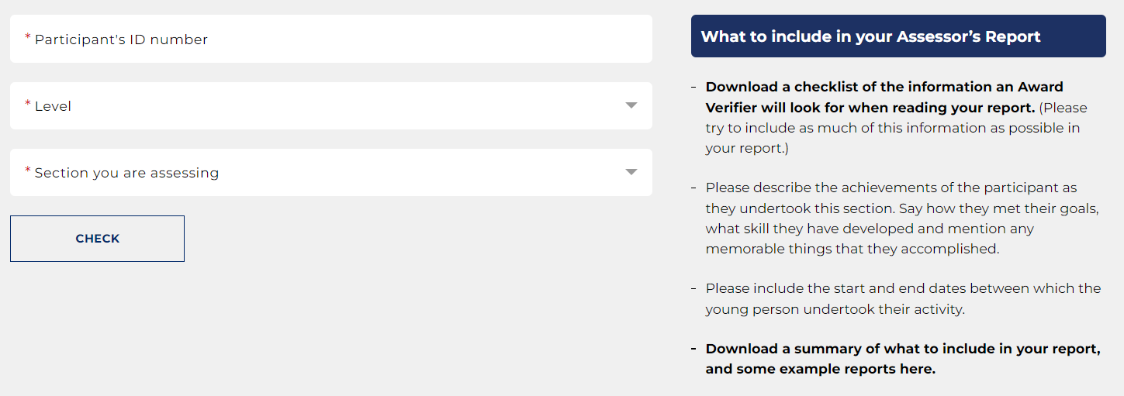
Assessor Reports
Assessor’s card
Assessor’s portal
www.dofe.org/assessor
Their Assessor will need to know:
The participant's eDofE number
The level they are doing
Which section they are assessing
This will go directly onto your eDofE record!
Participants will receive this in
their Welcome Pack
through the post
4 May 2021
Notes:
The assessor report is the only essential piece of evidence. An award cannot be completed without one of these for each section.
The report card can be submitted by taking a photo and uploading it directly to the app.
DofE.org/assessor is the website for the Assessor Portal.
If an online report is submitted, a leader will need to approve it under “assessor reports” when it will be sent to the young person’s account.

Slide 23
Costs
Welcome Packs:
Bronze: £33
Silver: £33
Gold: £38.50
Expedition Costs:
Approximately £75, covering coach hire and campsite fees. It is important to note however, this amount may change once we confirm final costs with the coach company and campsite.
Notes:
To take part in the DofE, participants pay a nominal fee. This fee is their contribution towards the charity’s costs in running their DofE programme and represents a personal commitment, adding value to their involvement. The fee represents a very small proportion of the overall cost which is supported by the funds raised by the DofE charity.

Slide 24

Getting started
Are you ready to support your young person to start an adventure they’ll never forget?
To get started speak to:
Mr Everall dofe@stmaryswallasey.com
The DofE is a charity. Visit DofE.org for more information.
Notes:
Presenter: Please customise this slide with the contact details of your DofE leader/administrator.
​Outline the next steps for parents:​
​Check the school / organisation’s process for signing up to DofE.​
​Parents / carers will need to complete and return some paperwork and payment.​
​Start a conversation with your young person about what activities they might choose for their DofE.​

